Slide 1
Cryptocurrency Analysis
Cryptocurrency is a recurring phenomenon, its popularity is effected by changes in public sentiment, coin caps and halving.

Slide 2
Purpose of Project
The purpose of the project was to analyse how cryptocurrencies have performed over the years as a result of its growing popularity.
We wanted to visualise how cryptocurrencies compared to mainstream currencies (USD/AUD) and to the original cryptocurrency, Bitcoin.
Hypotheses we wanted to test were as follows: -
- Does all Cryptocurrencies have a central index? i.e Bitcoin and other currencies
fluctuate up and down the same?
- How does a Cryptocurrency operate within a family? E.g Bitcoin and Bitcoin spin offs e.g Bitcoin Lite .

Slide 3
What did we look at?
There are many factors that affect Bitcoin:
Currency exchange rates
Fear in the market
World events such as terrorism or COVID-19.
Given the limits of time on this project, we decided to narrow our scope:
We looked at the following API to pull our data: https: //www.coinapi.io

Slide 4
What did we look at? Cont.
Using https: //www.coinapi.io:
Assets – e.g Bitcoin, Torcoin, Vegascoin
Market Symbols
Exchange-rates
OHLCV – open, high, low, close, volume

Slide 5
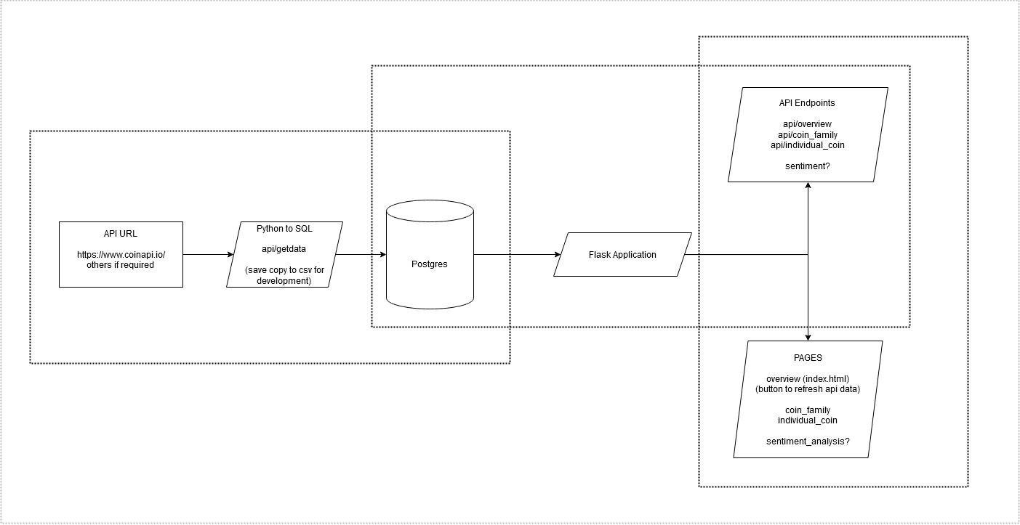
Flowchart

Slide 6
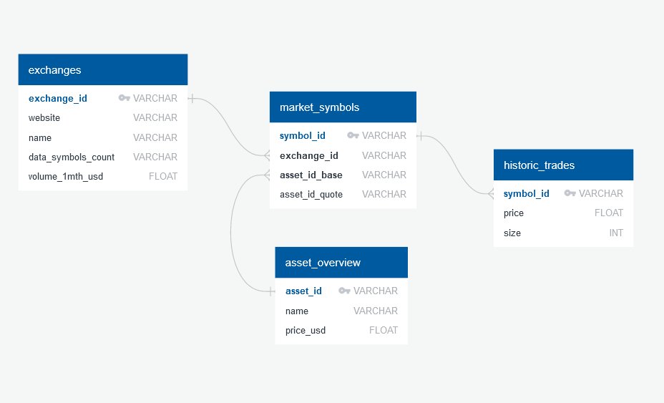
ERD – Database Relation Diagram

Slide 7
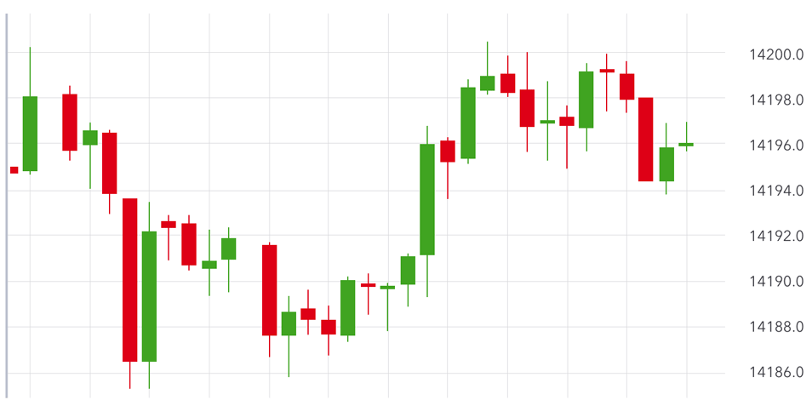
5
HOME | COINS | MARKETS | DATA | OUR TEAM
Top 5 $ value Coins
Top 5 Coins by Volume
Top 5 Exchanges by Volume
Top 5 Exchanges by Value
Last 20 trades (uses update function)
Volume / Value in past 24 hours

Slide 8
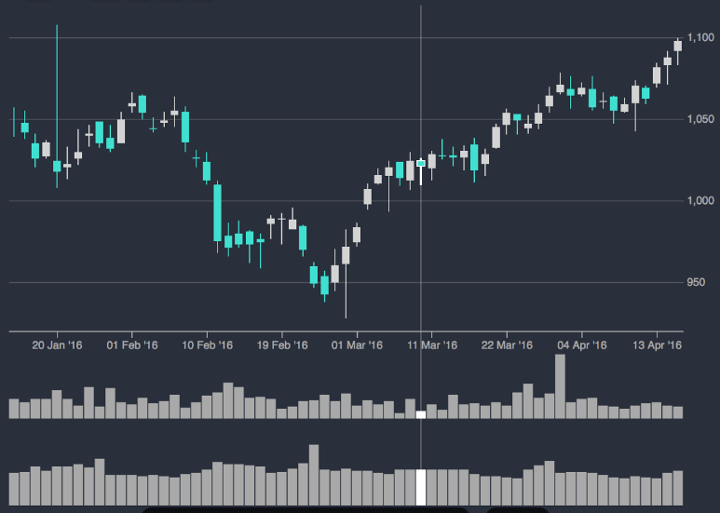
5
HOME | COINS | MARKETS | DATA | OUR TEAM
Top 5 $ value Coins in selected family
Top 5 Coins by Volume in selected family
Top 5 Exchanges by Trades in selected family
Top 5 Exchanges by Value in selected family
Last 20 trades on selected coin (uses update function)
OR Comparison between 5 coins using statical analysis
BTC
AUD

Slide 9
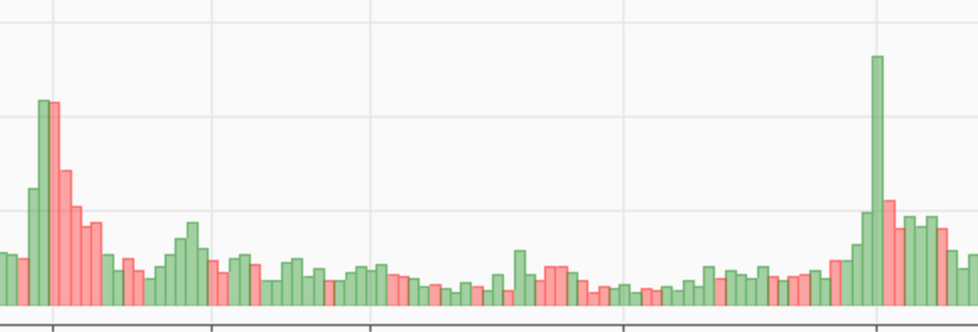
5
HOME | COINS | MARKETS | DATA | OUR TEAM
Top 5 Exchanges by $
Top 5 Exchanges by volume
# coin varieties traded by selected exchange
Total Volume traded in 1 month by selection
Last 20 trades by volume (uses update function)
EXCHANGE

Slide 10
5
HOME | COINS | MARKETS | DATA | OUR TEAM
Problems encountered.
Problems with coding and resolutions. Not enough in-depth knowledge and skill-set to resolve matters. A lot of time spent on resolving database issues and trying to get the API’s to work with d3.js
Process
Webpages: No dropdown menus used due to lack of time. No leaflet.
In the database we had 11,000 lines and had to drop coins/asset_ID that didn’t have any numerical $ value.
SQL used is Postgres. This enabled joins to be done between database tables that linked different API’s called.

Slide 11
5
HOME | COINS | MARKETS | DATA | OUR TEAM
Picture of code monkey #1
Picture of code monkey #2
Picture of code monkey #2
Picture of code monkey #2
Bio Info
Bio Info
Bio Info
Bio Info

Slide 12
Our Code
https://github.com/gmcglinn41/Cryptocurrency_Analysis

Slide 13
Challenges
When attempting to connect to our app routes we kept receiving a 404 error in the console. After two evenings of troubleshooting we were unable to resolve the issue and therefore could not use or present our data in visualisations using d3.js
We managed to get one visualization working after one day resolving the Flask routes
More time is required.

Slide 14
Conclusions
We were unable to test our hypothesis due to the challenges outlined earlier.

